Slide 1

SECI1143
Probability & statistical data analysis
CHAPTER 8
Analysis of Variance
(ANOVA)

Slide 2
Outline
Introduction
One-Way ANOVA with Equal Sample Sizes.
One-Way ANOVA with Unequal Sample Sizes.
Two-Way ANOVA.
Not covered in this syllabus

Slide 3
Introduction
ANOVA is a method of testing the equality of three or more population means by analyzing sample variances.
The purpose of ANOVA is to test for significant differences between Means.
Elementary concepts provide a brief introduction to the basics of statistical significance testing.

Slide 4
One-Way ANOVA with Equal Sample Sizes
We assume that the populations have normal distribution and same variance (or standard deviation), and the samples are random and independent of each other.
ANOVA Notation: n = size of each sample k = number of populations or treatments being compared = variance sample means = pooled variance obtained by calculating the mean of the sample variances

Slide 5
One-Way ANOVA with Equal Sample Sizes
Test statistic:
Variance between sample:
  Also called variation due to treatment
  An estimate of the common population variance σ² that is based on the variability among the sample means.
Variance within sample:
  Also called variation due to error.
  An estimate of the common population variance σ² based on the sample variances.

Slide 6
One-Way ANOVA with Equal Sample Sizes
The critical value of F:
  numerator degrees of freedom = k – 1
  denominator degrees of freedom = k(n - 1)
  k = number of population or treatments being compared.
  n = sample size

Slide 7
Example 1
Table below lists the head injury to car crash test dummies for four different types of cars. Use a 0.05 significance level to test the null hypothesis that the different types of car have the same mean.
No. of head injury
Subcompact Cars | Compact Cars | Midsize Cars | Full-Size Cars
681 | 643 | 469 | 384
428 | 655 | 727 | 656
917 | 442 | 525 | 602
898 | 514 | 454 | 687
420 | 525 | 259 | 360

Slide 8
Example 1
Step 1: Define hypothesis.
  H₀ : μ₁ = μ₂ = μ₃ = μ₄
  H₁ : at least one mean is different.
Step 2: For each category, find

Slide 9
Example 1
Category 1: (Subcompact Cars)
Category 2: (Compact Cars)

Slide 10
Example 1
Category 3: (Midsize Cars)
Category 4: (Fullsize Cars)

Slide 11
Example 1
Step 3: Find variance between samples
  Step 3a: Find mean between samples
Step 3b: Find standard deviation between samples
Step 3c: Find variance between samples

Slide 12
Example 1
Step 4: Find variance within samples
Step 5: Calculate test statistic, F

Slide 13
Example 1
Step 6: Calculate numerator and denominator degree of freedom
  Numerator = k – 1 = 4 – 1 = 3
  Denominator = k(n – 1) = 4(5 – 1) = 16
Step 7: Find critical value of F with α = 0.05 from F-distribution table
  F critical value = 3.2389

Slide 14
Example 1
Step 8: Test the claim and state the conclusion.
  Since F_{test statistic} < F_{critical value} (0.992 < 3.2389), we fail to reject the null hypothesis.
  There is sufficient evidence to claim that the different types of cars have the same mean for head injury.

Slide 15
Example 2
Table below lists the chest deceleration to car crash test dummies for four different types of cars. Use a 0.05 significance level to test the null hypothesis that the different types of car have the same mean.
Subcompact Cars | Compact Cars | Midsize Cars | Full-Size Cars
n = 5 | n = 5 | n = 5 | n = 5
s = 6.69 | s = 4.64 | s = 3.35 | s = 7.11

Slide 16
Example 2
Step 1: State the hypothesis.
  H₀ : μ₁ = μ₂ = μ₃ = μ₄
  H₁ : at least one mean is different.
Step 2: (Done – refer table).
Step 3: Find variance between samples
  Step 3a: Find mean between samples
Step 3b: Find standard deviation between samples
Step 3c: Find variance between samples

Slide 17
Example 2
Step 4: Find variance within samples
Step 5: Calculate test statistic, F

Slide 18
Example 2
Step 6: Calculate numerator and denominator degree of freedom
  Numerator = k – 1 = 4 – 1 = 3
  Denominator = k(n – 1) = 4(5 – 1) = 16
Step 7: Find critical value of F with α = 0.05 from F-distribution table
  F critical value = 3.2389

Slide 19
Example 2
Step 8: Test the claim and state the conclusion.
  Since F_{test statistic} < F_{critical value} (1.34 < 3.2389), we fail to reject the null hypothesis.
  There is sufficient evidence to claim that the different types of cars have the same mean for chest deceleration.

Slide 20
Exercise #1
Table 1 lists the body temperatures of 5 randomly selected subjects from each of 3 different age groups. Informal examination of the 3 sample means (97.940, 98.580, 97.800) seems to suggest that the 3 samples come from populations with means that are not significantly different. Test the claim that the 3 age-group populations have the same mean body temperature. Use α= 0.05.

Slide 21
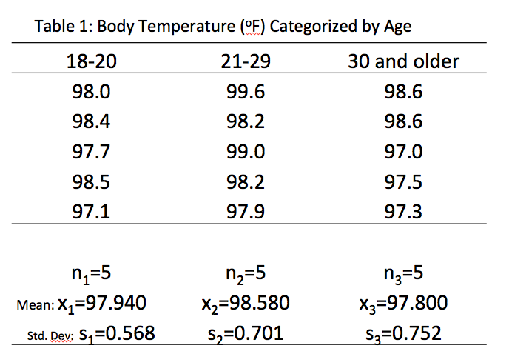
Exercise #1

Slide 22
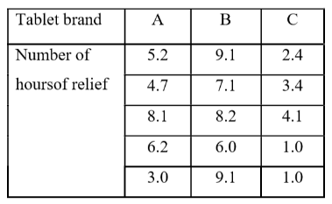
Exercise #2
Data in the following Table 1 represent the number of hours of relief provided by five different brands of headache tablets given to 25 patients experiencing fevers of 38° Celsius or more. Perform the analysis of variance (ANOVA) and test the hypothesis at 0.05 level of significance that the mean number of hours of relief provided by the tablets is the same for all five brands. Provide your evidence.
Table 1

